Slide 1
July 2026 Student Loan Update for Pre-PA Students, PA Students, and Advisors
Tyler Smith, MPH
Chief Policy Officer
Catherine Majewski
Manager, Government Relations

Slide 2
Agenda
Overview of How PA School is Paid For
Pre-July 2026 System and Changes in H.R. 1/One Big Beautiful Bill Act
What is a Professional Student/Degree?
PAEA-AAPA Lawsuit
Where We Stand Now
Ongoing Advocacy
Student Loan Repayment/Forgiveness Options
Key Takeaways
Q&A

Slide 3
How Do PA Students Pay For School?
Federal Loans
  85%+ of PA students rely upon federal student loans to some degree to complete their education
  Per the Department of Education, 75%+ of students require more than $20,500 per year to complete their programs
  Most favorable interest/repayment terms – eligibility for many service-based forgiveness programs
Private Loans
  Require good credit history/co-signers, often higher interest rates, fewer protections/repayment options
Scholarships
Personal Savings

Slide 4
Federal Loan Structure Pre-July 2026
Unsubsidized Direct Loans
  $20,500 annual limit (lowest federal interest rate)
Grad PLUS loans
  Available up to the institutionally-determined cost of attendance (slightly higher interest rates)
Most PA students could finance the entirety of their education through a combination of Unsubsidized Direct and Grad PLUS loans – avoiding the private market altogether

Slide 5
Changes in H.R. 1/One Big Beautiful Bill Act
Elimination of Grad PLUS loans for new borrowers after July 1, 2026
Establishment of new Unsubsidized Direct loan limits
  For graduate students: $20,500 annual/$100,000 aggregate
  For professional students: $50,000 annual/$200,000 aggregate
Note: Because PA programs typically don’t span four academic years, the annual limit is more important in determining the level of aid that students actually have access to

Slide 6
Important Question: What is a Professional Student/Degree?
Per H.R. 1:
  A degree that signifies both completion of the academic requirements for beginning practice in a given profession and a level of professional skill beyond that normally required for a bachelor's degree. Professional licensure is also generally required. Examples of a professional degree include but are not limited to Pharmacy (Pharm.D.), Dentistry (D.D.S. or D.M.D.), Veterinary Medicine (D.V.M.), Chiropractic (D.C. or D.C.M.), Law (L.L.B. or J.D.), Medicine (M.D.), Optometry (O.D.), Osteopathic Medicine (D.O.), Podiatry (D.P.M., D.P., or Pod.D.), and Theology (M.Div., or M.H.L.).

Slide 7
Department of Education Implementation
During negotiated rulemaking sessions in fall 2025, the Department of Education added additional criteria beyond those required by Congress to determine professional student status:
  Doctoral-level requirement
  Specific Classification of Instructional Programs placement
  Cannot be supervised in clinical practice
These criteria went beyond what Congress directed the Department of Education to use and are the basis of PAEA and AAPA’s lawsuit against the Department.

Slide 8
PAEA and AAPA Lawsuit
On June 3, PAEA and AAPA sued the Department of Education, arguing the agency exceeded its authority in imposing new criteria with the effect of excluding incoming PA students
Two requests:
  Preliminary injunction – PAEA and AAPA asked the court to halt implementation of the amended professional degree definition before July 1
  Underlying complaint – PAEA and AAPA asked the court to assess our claims on the merits to provide permanent professional degree access for PA students

Slide 9
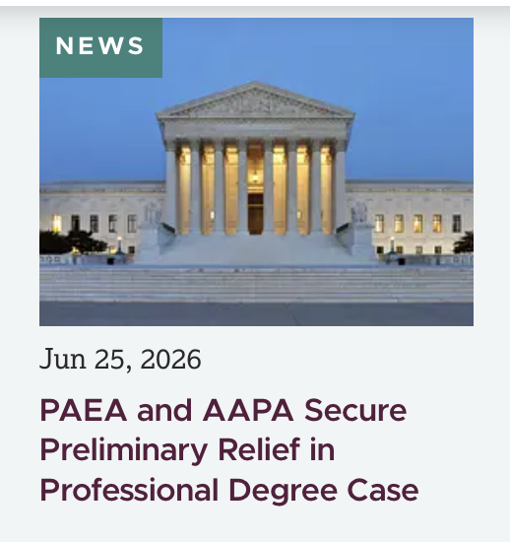
Initial Outcome
In late June, the court granted PAEA and AAPA’s request to block implementation of the professional degree definition finalized by the Department of Education.

Slide 10
Finding
“[Plaintiffs’] have established that they are likely to succeed on their [Administrative Procedure Act] claim that the Rule’s definition of ‘professional degree’ is contrary to law, that they would suffer irreparable harm should the Rule go into effect, and that the balance of equities and the public interest are in their favor.” – Judge Beryl Howell

Slide 11
Where We Stand Now
On June 29, the Department of Education issued guidance classifying programs, including PA programs, that will be designated as professional while the court’s preliminary order remains in place
The case now moves to consideration on the merits, which is anticipated to take place over a number of months
Congress can act to provide long-term certainty to PA and other health professions students

Slide 12
What Does This Mean for You?
Pre-PA Students
  If you are planning to apply to PA school, do not let this issue discourage you from pursuing a PA education.
  While this issue is still being resolved, PAEA and AAPA are actively working through the courts and Congress to protect access to affordable federal student financing.
  Continue planning for PA school and stay informed as updates become available.
Current PA Students
  Continue working with your financial aid office regarding your individual borrowing needs.
  PA students enrolled and borrowing for their programs prior to July 1 are grandfathered into Grad PLUS loans and should not be impacted by the professional degree issue.

Slide 13
What Does This Mean for You? (cont.)
PA Programs & Advisors
  Continue directing students to institutional financial aid professionals for individualized financial aid guidance.
  Encourage prospective and current students to rely on official updates from PAEA, AAPA, and the Department of Education.

Slide 14
PAEA Advocacy Efforts
Professional Student Degree Act
  Endorsed by PAEA and AAPA
  Would explicitly name PA and other key professions as professional students to provide long-term certainty
Appropriations Legislation
  Another potential avenue for Congress to direct the Department of Education to explicitly include PA/other professions as professional students

Slide 15
What About Other Key Programs?
Additional pathways to pay for PA school/obtain loan repayment aid still exist:
  National Health Service Corps scholarship/loan repayment programs
  Public Service Loan Forgiveness (PSLF) program
  Armed Services-based educational aid
Note: Some programs such as PSLF restrict forgiveness/repayment to federal loans.

Slide 16
What Can You Do?
Monitor PAEA and AAPA channels for updates on the court case, advocacy efforts, and guidance from the Department of Education
Participate in PAEA’s Grassroots Action Network campaigns in support of the Professional Student Degree Act

Slide 17
Key Takeaways
PA education remains an excellent investment in a rewarding healthcare career.
The court's preliminary order currently allows PA students to continue being treated as professional students for federal borrowing purposes while the case moves forward.
PAEA and AAPA remain actively engaged in both the courts and Congress to secure long-term certainty for PA students.
We are committed to keeping students, advisors, and PA programs informed every step of the way.
Institutional financial aid offices are directly responsible for administering access to federal student loans and can best answer individualized questions.

Slide 18
Q&A

